Slide 1



Welcome to
CS 345 Operating Systems
Virtual Memory (23)

Slide 2
Tip #23: Designated Initializer
If you initialize even one object / variable in the struct, all of its other variables will be initialized to default value.
If no values are initialized, all variables will contain "garbage values" (if local).
typedef struct Item
{
int a;
float b;
char* name;
} Item;
int main(void)
{
Item item = {5, 2.2, "Tom"};
return 0;
}
int main(void)
{
Item item = {
.b = 2.2,
.name = "Tom",
.a = 5
};
return 0;
}
Or you can use a designated initializer (in any order.)
Omitted fields members of global or static type are implicitly initialized.

Slide 3
Virtual Memory

Slide 4
8 Frames... 0x3040 ⇨ ??
FR____|S____
x3000
(192)
Frame
Page
10_199|1___0
0xxxxx|1___1
...
00____|0____
Virtual
Address
Physical
Address
x2400
RPT0
00____|0____
00____|0____
00____|0____
00____|0____
00____|0____
00____|0____
10_192|0____
0xxxxx|1___6
...
11_194|1___4
00____|0____
10_195|0____
10_198|0____
00____|0____
Disk
Storage
x0000–x07FF
x0800–x0FFF
x1000–x17FF
x1800–x1FFF
x2000–x27FF
x2800–x2FFF
x3000–x37FF
x3800–x3FFF
...
xD800–xDFFF
xE000–xE7FF
xE800–xEFFF
xF000–xF7FF
xF800–xFFFF
x0000–x07FF
x0800–x0FFF
x1000–x17FF
x1800–x1FFF
x2000–x27FF
x2800–x2FFF
x3000–x37FF
x3800–x3FFF
...
xD800–xDFFF
xE000–xE7FF
xE800–xEFFF
xF000–xF7FF
xF800–xFFFF
0x3000
⇒ 0x3040
x3040
(193)
0x3001
⇒ 0x3041
xD800-xD83F
Data Frame
0x3040
⇒ 0x3080
0x3041
⇒ 0x3081
x3080
(194)
11_193|1___2
0xxxxx|1___3
...
00____|0____
0xEFD2
⇒ 0x3112
#0 – x3000
0xD851
⇒ 0x3191
#1 – x3040
0xD833
⇒ 0x31F3
x30C0
(195)
0x3873
⇒ 0x30B3
00____|0____
00____|0____
...
10_196|0____
#2 – xD800
0x3000
⇒ 0x31C0
#3 – xD840
0xF7C5
⇒ 0x3145
x3100
(196)
#4 – UPT1
0xEFF0
⇒ 0x3130
#5 – x3800
0xD807
⇒ 0x3047
xEF80-xEFFF
Data Frame
0x3040
x2440
RPT1
00____|0____
00____|0____
00____|0____
00____|0____
...
#6 – UPT2
x3140
(197)
xF740-xF7FF
Data Frame
x3180
(198)
00____|0____
00____|0____
...
10_197|0____
x31C0
(199)
x3000-x303F
Data Frame
x3200

Slide 5
8 Frames...
FR____|S____
x3000
(192)
Frame
Page
10_199|1___0
0xxxxx|1___1
...
00____|0____
Virtual
Address
Physical
Address
x2400
RPT0
00____|0____
00____|0____
00____|0____
00____|0____
00____|0____
00____|0____
10_192|0____
0xxxxx|1___6
...
11_194|1___4
00____|0____
10_195|0____
10_198|0____
00____|0____
11_196|1___1
Disk
Storage
x0000–x07FF
x0800–x0FFF
x1000–x17FF
x1800–x1FFF
x2000–x27FF
x2800–x2FFF
x3000–x37FF
x3800–x3FFF
...
xD800–xDFFF
xE000–xE7FF
xE800–xEFFF
xF000–xF7FF
xF800–xFFFF
x0000–x07FF
x0800–x0FFF
x1000–x17FF
x1800–x1FFF
x2000–x27FF
x2800–x2FFF
x3000–x37FF
x3800–x3FFF
...
xD800–xDFFF
xE000–xE7FF
xE800–xEFFF
xF000–xF7FF
xF800–xFFFF
0x3000
⇒ 0x3040
x3040
(193)
0x3001
⇒ 0x3041
xD800-xD83F
Data Frame
0x3040
⇒ 0x3080
0x3041
⇒ 0x3081
x3080
(194)
11_193|1___2
0xxxxx|1___3
...
00____|0____
0xEFD2
⇒ 0x3112
11_192
#0 – x3000
0xD851
⇒ 0x3191
#1 – x3040
0xD833
⇒ 0x31F3
x30C0
(195)
0x3873
⇒ 0x30B3
10_194
00____|0____
00____|0____
...
10_196|0____
#2 – xD800
0x3000
⇒ 0x31C0
#3 – xD840
0xF7C5
⇒ 0x3145
x3100
(196)
0xxxxx|1___7
#4 – UPT1
0xEFF0
⇒ 0x3130
#5 – x3800
0xD807
⇒ 0x3047
x3040-x307F
Data Frame
x2440
RPT1
xEF80-xEFFF
Data Frame
#6 – UPT2
0x3040
⇒ 0x3100
00____|0____
00____|0____
00____|0____
00____|0____
...
x3140
(197)
#7 – xEF80
xF740-xF7FF
Data Frame
x3180
(198)
00____|0____
00____|0____
...
10_197|0____
x31C0
(199)
x3000-x303F
Data Frame
x3200

Slide 6
8 Frames...
FR____|S____
x3000
(192)
Frame
Page
10_199|1___0
11_196|1___1
...
00____|0____
Virtual
Address
Physical
Address
x2400
RPT0
00____|0____
00____|0____
00____|0____
00____|0____
00____|0____
00____|0____
11_192|0____
0xxxxx|1___6
...
10_194|1___4
00____|0____
10_195|0____
10_198|0____
00____|0____
Disk
Storage
x0000–x07FF
x0800–x0FFF
x1000–x17FF
x1800–x1FFF
x2000–x27FF
x2800–x2FFF
x3000–x37FF
x3800–x3FFF
...
xD800–xDFFF
xE000–xE7FF
xE800–xEFFF
xF000–xF7FF
xF800–xFFFF
x0000–x07FF
x0800–x0FFF
x1000–x17FF
x1800–x1FFF
x2000–x27FF
x2800–x2FFF
x3000–x37FF
x3800–x3FFF
...
xD800–xDFFF
xE000–xE7FF
xE800–xEFFF
xF000–xF7FF
xF800–xFFFF
0x3000
⇒ 0x3040
x3040
(193)
0x3001
⇒ 0x3041
xD800-xD83F
Data Frame
0x3040
⇒ 0x3080
0x3041
⇒ 0x3081
x3080
(194)
11_193|1___2
0xxxxx|1___3
...
00____|0____
0xEFD2
⇒ 0x3112
#0 – x3000
0xD851
⇒ 0x3191
#1 – x3040
0xD833
⇒ 0x31F3
x30C0
(195)
00____|0____
00____|0____
...
0xxxxx|1___7
#2 – xD800
0x3873
⇒ 0x30B3
00____|0____
00____|0____
...
00____|0____
0x3000
⇒ 0x31C0
#3 – xD840
0xF7C5
⇒ 0x3145
0xxxxx|1___8
x3100
(196)
11_197|0____
#4 – UPT1
0xEFF0
⇒ 0x3130
#5 – x3800
0xD807
⇒ 0x3047
11_195
x3040-x307F
Data Frame
0x3040
⇒ 0x3100
x2440
RPT1
00____|0____
00____|0____
00____|0____
00____|0____
...
#6 – UPT2
0xFFC8
⇒ 0x3148
x3140
(197)
#7 – xEF80
xFFC0-xFFFF
Data Frame
#8 – UPT3
xF740-xF7FF
Data Frame
x3180
(198)
#9 – F740
00____|0____
00____|0____
...
10_197|0____
x31C0
(199)
0xxxxx|1___9
x3000-x303F
Data Frame
x3200

Slide 7
8 Frames...
FR____|S____
x3000
(192)
Frame
Page
10_199|1___0
11_196|1___1
...
00____|0____
Virtual
Address
Physical
Address
x2400
RPT0
11_199|1___0
Disk
Storage
00____|0____
00____|0____
00____|0____
00____|0____
00____|0____
00____|0____
11_192|0____
0xxxxx|1___6
...
10_194|1___4
00____|0____
0xxxxx|1___8
10_198|0____
11_195|0____
x0000–x07FF
x0800–x0FFF
x1000–x17FF
x1800–x1FFF
x2000–x27FF
x2800–x2FFF
x3000–x37FF
x3800–x3FFF
...
xD800–xDFFF
xE000–xE7FF
xE800–xEFFF
xF000–xF7FF
xF800–xFFFF
x0000–x07FF
x0800–x0FFF
x1000–x17FF
x1800–x1FFF
x2000–x27FF
x2800–x2FFF
x3000–x37FF
x3800–x3FFF
...
xD800–xDFFF
xE000–xE7FF
xE800–xEFFF
xF000–xF7FF
xF800–xFFFF
0x3000
⇒ 0x3040
x3040
(193)
0x3001
⇒ 0x3041
xD800-xD83F
Data Frame
0x3040
⇒ 0x3080
0x3041
⇒ 0x3081
x3080
(194)
11_193|1___2
0xxxxx|1___3
...
00____|0____
0xEFD2
⇒ 0x3112
#0 – x3000
0xD851
⇒ 0x3191
#1 – x3040
0xD833
⇒ 0x31F3
x30C0
(195)
0x3873
⇒ 0x30B3
00____|0____
00____|0____
...
11_197|0____
#2 – xD800
0x3000
⇒ 0x31C0
#3 – xD840
0xF7C5
⇒ 0x3145
x3100
(196)
#4 – UPT1
0xEFF0
⇒ 0x3130
#5 – x3800
0xD807
⇒ 0x3047
x3040-x307F
Data Frame
0x3040
⇒ 0x3100
x2440
RPT1
00____|0____
00____|0____
00____|0____
00____|0____
...
#6 – UPT2
0xFFC8
⇒ 0x3148
x3140
(197)
#7 – xEF80
0x303C
⇒ 0x31FC
xFFC0-xFFFF
Data Frame
#8 – UPT3
xF740-xF7FF
Data Frame
x3180
(198)
#9 – F740
00____|0____
00____|0____
...
0xxxxx|1___9
x31C0
(199)
x3000-x303F
Data Frame
x3200

Slide 8
8 Frames...
FR____|S____
x3000
(192)
Frame
Page
11_199|1___0
11_196|1___1
...
00____|0____
Virtual
Address
Physical
Address
x2400
RPT0
10_199
Disk
Storage
00____|0____
00____|0____
00____|0____
00____|0____
00____|0____
00____|0____
11_192|0____
0xxxxx|1___6
...
10_194|1___4
00____|0____
0xxxxx|1___8
10_198|0____
11_195|0____
x0000–x07FF
x0800–x0FFF
x1000–x17FF
x1800–x1FFF
x2000–x27FF
x2800–x2FFF
x3000–x37FF
x3800–x3FFF
...
xD800–xDFFF
xE000–xE7FF
xE800–xEFFF
xF000–xF7FF
xF800–xFFFF
10_196
x0000–x07FF
x0800–x0FFF
x1000–x17FF
x1800–x1FFF
x2000–x27FF
x2800–x2FFF
x3000–x37FF
x3800–x3FFF
...
xD800–xDFFF
xE000–xE7FF
xE800–xEFFF
xF000–xF7FF
xF800–xFFFF
0x3000
⇒ 0x3040
x3040
(193)
0x3001
⇒ 0x3041
xF000-xF03F
Data Frame
0x3040
⇒ 0x3080
xD800-xD83F
Data Frame
0x3041
⇒ 0x3081
x3080
(194)
11_193|1___2
0xxxxx|1___3
...
00____|0____
10_193
0xEFD2
⇒ 0x3112
10_192
0xxxxx
#0 – x3000
0xD851
⇒ 0x3191
#1 – x3040
0xD833
⇒ 0x31F3
x30C0
(195)
0x3873
⇒ 0x30B3
00____|0____
00____|0____
...
11_197|0____
#2 – xD800
0x3000
⇒ 0x31C0
#3 – xD840
0xF7C5
⇒ 0x3145
x3100
(196)
10_197
#4 – UPT1
0xEFF0
⇒ 0x3130
11_198
11_198
10_198
#5 – x3800
0xD807
⇒ 0x3047
10_195
x3040-x307F
Data Frame
0x3040
⇒ 0x3100
x2440
RPT1
00____|0____
00____|0____
00____|0____
00____|0____
...
#6 – UPT2
0xFFC8
⇒ 0x3148
x3140
(197)
#7 – xEF80
0x303C
⇒ 0x31FC
xFFC0-xFFFF
Data Frame
#8 – UPT3
xF740-xF7FF
Data Frame
0xF000
⇒ 0x3040
#9 – F740
x3180
(198)
00____|0____
00____|0____
...
0xxxxx|1___9
11_193
x31C0
(199)
x3000-x303F
Data Frame
x3200

Slide 9
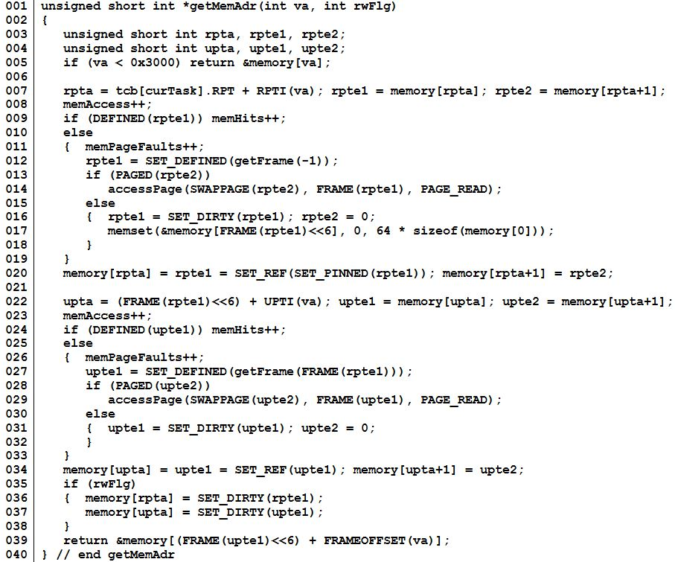
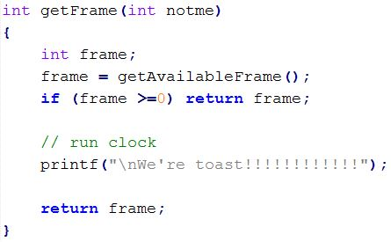
1. What is the purpose of the variable tcb[curTask].RPT?
1. Each task
has its own RPT.
2. What is the purpose of line 005?
2. Turn MMU off
for system memory.
3. Root directory entries.
rpte1 = memory frames
rpte2 = swap space pages
3. What is the purpose of variables “rpte1” and “rpte2”?
4. All frames may be
be used for UPT.
4. Why is the function getFrame’s parameter -1?
5. Read back a
swapped UPT
5. What is the purpose of line 014?
6. Define all UPT entries by
setting values to zero (default).
6. What is the purpose of line 017?
7. Prevent the current UPT
from being selected as the
data frame.
8. New memory is
garbage.
Why is the function getFrame’s parameter
rpte1 (line 027)?
8. Why isn’t a new data frame initialized (line 031)
9. Memory dirtied by
calling function.
9. What is the purpose of lines 35-38?

Slide 10
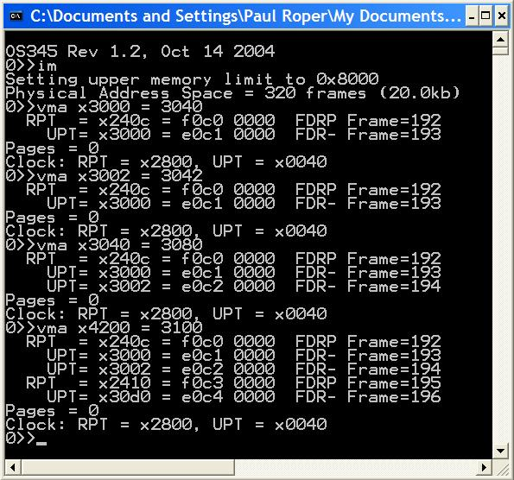
vma
2 frames – UPT, Frame
No new frames
Same UPT, new Frame
No swap pages
New UPT, new Frame
Clock did not advance

Slide 11
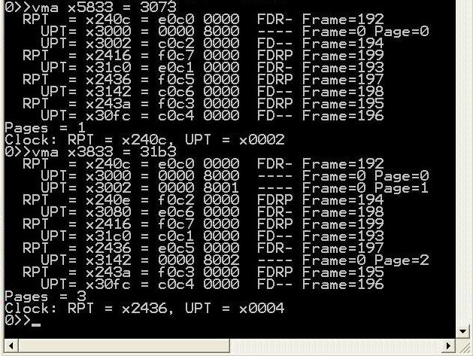
vma

Slide 12
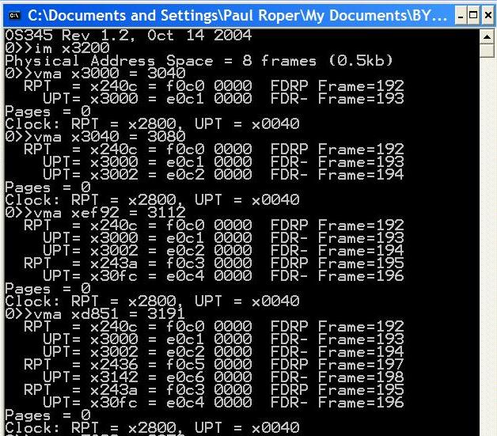
Implementation Demo
Notes:
12

Slide 13
vma
2 frames – UPT, Frame
No new frames
Same UPT, new Frame
No swap pages
New UPT, new Frame
Clock did not advance

Slide 14
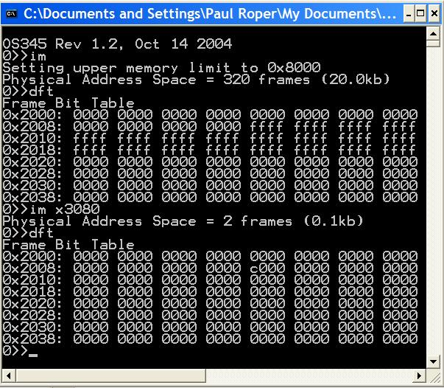
Frame Bit Table
0x3000
0x8000
2 Frames

Slide 15
accessPage
// *************************************************************************
// read/write to swap space
int accessPage(int pnum, int frame, int rwnFlg)
{ static int nextPage; // swap page size
static int pageReads; // page reads
static int pageWrites; // page writes
static unsigned short int swapMemory[LC3_MAX_SWAP_MEMORY];
if ((nextPage >= LC3_MAX_PAGE) ||
(pnum >= LC3_MAX_PAGE))
{
printf("\nVirtual Memory Space Exceeded! (%d)",
LC3_MAX_PAGE);
exit(-4);
}
switch(rwnFlg)
{
case PAGE_INIT: // init paging
clockRPT = 0; // clear RPT clock
clockUPT = 0; // clear UPT clock
memAccess = 0; // memory accesses
memHits = 0; // memory hits
memPageFaults = 0; // memory faults
nextPage = 0; // disk swap space size
pageReads = 0; // disk page reads
pageWrites = 0; // disk page writes
return 0;
case PAGE_GET_SIZE: // return swap size
return nextPage;
case PAGE_GET_READS: // return swap reads
return pageReads;
case PAGE_GET_WRITES: // return swap writes
return pageWrites;
case PAGE_GET_ADR: // return page address
return (int)(&swapMemory[pnum<<6]);
case PAGE_NEW_WRITE: // new write
pnum = nextPage++;
case PAGE_OLD_WRITE: // write
memcpy(&swapMemory[pnum<<6],
&memory[frame<<6], 1<<7);
pageWrites++;
return pnum;
case PAGE_READ: // read
memcpy(&memory[frame<<6],
&swapMemory[pnum<<6], 1<<7);
pageReads++;
return pnum;
case PAGE_FREE: // free page
printf("\nPAGE_FREE not implemented");
break;
}
return pnum;
} // end accessPage

Slide 16
Virtual Memory Guidelines
Verify a clean compilation of your LC-3 virtual memory simulator. Validate that “crawler.hex” and “memtest.hex” programs execute properly.
Modify the getMemAdr() function to handle a 2-level, paging, virtual memory addressing.
Implement a clock page replacement algorithm to pick which frame is unloaded, if necessary, on a page fault.
Use the provided 1MB page swap table routine to simulate paged disk storage (8192 pages) or implement your own routine.
Use crawler.hex and memtest.hex to validate your virtual memory implementation. Use other routines (such as im) to debug you implementation.

Slide 17
Virtual Memory Guidelines
Use the following CLI commands to verify and validate your virtual memory system. (Most of these routines are provided, but may require some adaptation to your system.)
dfm <#> Display LC3 memory frame <#>
dft Display frame allocation table
dm <sa>,<ea> Display physical LC3 memory from <sa> to <ea>
dp <#> Display page <#> in swap space
dv <sa>,<ea> Display virtual LC3 memory <sa> to <ea>
im <#> Init LC3/Set upper LC3 memory limit
rpt <#> Display task <#> root page table
upt <p><#> Display task <p> user page table <#>
vma <a> Access <a> and display RPTE’s and UPTE’s
vms Display LC3 statistics

Slide 18
Virtual Memory Guidelines
Demonstrate that LC-3 tasks run correctly. Be able to dynamically change LC-3 memory size (im command) and chart resulting changes in page hits/faults. Memory accesses, hits and faults are defined as follows:
Memory access (memAccess) = sum of memory hits (memHits) and memory faults (memPageFaults).
Hit (memHits) = access to task RPT, UPT, or data frame. (Exclude accesses below 0x3000.)
Fault (memPageFaults) = access to a task page that is undefined or not currently in a memory frame.
Page Reads (pageReads) = # pages read from swap space into memory.
Page Writes (pageWrites) = # pages written from memory to swap space.
Swap Page (nextPage) = # of swap space pages currently allocated to swapped pages.
 | Crawler |  |  | Memtest
Frames: | 320 | 16 | 2 | 320 | 16 | 2
Accesses:
Hits:
Faults:
Page Reads:
Page Writes:
Swap Pages:

Slide 19
Project 4 Grading Criteria
REQUIRED:
8 pts – Successfully execute crawler and memtest in 20k words (320 frames).
6 pts – Successfully execute crawler and memtest in 1k words (16 frames).
2 pts – Successfully execute 5 or more LC-3 tasks simultaneously in 16 frames of LC-3 memory.
2 pts – Correctly use the dirty bit to only write altered or new memory frames to swap space.
2 pts – Chart and submit the resulting memory access, hit, fault, and swap page statistics after executing crawler (and then memtest) in 320 and 16 frames.
BONUS:
+2 points – early pass-off (at least one day before due date.)
+2 points – Add a per/task frame/swap page recovery mechanism of a terminated task.
+1 point – Implement the advanced clock algorithm (Stallings, pp. 372-373).
+1 point – Implement an additional replacement policy and chart the results.
+2 points – Join the 2-frame club. (Successfully execute 5 or more LC-3 tasks simultaneously in
2 frames of LC-3 memory. Chart the memory accesses, hits, and faults.)
–2 points penalty for each school day late.

Slide 20
Steps to Success
Read and comprehend Stallings, Section 8.1.
Comprehend the lab specs.
Discuss questions with classmates, the TA’s and/or the professor.
Make sure you understand what the requirements are!
It's a tragedy to code for 20 hours and then realize you're doing everything wrong.
Validate that the demo LC-3 simulator works for a single task with pass-through addressing (virtual equals physical) for the LC-3 by executing the commands “crawler” and “memtest”.
Design your MMU. Break the problem down into manageable parts.
Create and validate a “clock” mechanism that accesses all global root page tables, user page tables, and data frames.
Implement dirty bit last – use “write-through” for all swapping of a data frame to swap space.

Slide 21
So…
Incrementally add support for the actual translation of virtual addresses to physical addresses with page fault detection as follows:
Implement page fault frame replacement using available memory frames only. This should allow you to execute any test program in a full address space.
Implement clock page replacement algorithm to unload data frames to swap pages and reload with a new frame or an existing frame from swap space. This should allow you to execute all the test programs in a 32k word address space (20k of paging frames).
Implement clock page replacement algorithm to unload User Page Tables when there are no physical data frame references in the UPT. This will be necessary when running in a small physical space (16k words) with multiple tasks.
Implement dirty bit to minimize writing frames to swap space.

Slide 22
Hints…
Remember to always increment your clock after finding a replacement frame.
Use the vma function to access a single virtual memory location and then display any non-zero RPT and UPT entries.
Implement various levels of debug trace to watch what is going on in your MMU.
You may use the provided display functions.
When swapping a user page table to swap space, add some debug “sanity check” code to validate that the UPT does not have any entries with the frame bit set.

Slide 23
UPT Clock…
if (REFERENCED(rpte1))
{
rpte1 = CLEAR_REF(rpte1);
MEMWORD(rpta) = rpte1;
} else
{

Slide 24
Is Virtual Paging A Dead Issue?
Recent revival in page replacement research.
Size of primary storage has increased - algorithms that require a periodic check of each and every memory frame are becoming less and less practical.
Memory hierarchies have grown taller - the cost of a CPU cache miss is far more expensive. This exacerbates the previous problem.
Object-oriented programming techniques have weakened locality of reference.
Sophisticated data structures like trees and hash tables and the advent of garbage collection have drastically changed the memory access behavior of applications.

Slide 25
Paging Improvements?
Disk access techniques
Use larger blocks.
Separate swap space from normal file storage - no file table lookup.
Enforce binary boundaries.
Load several consecutive sectors/pages rather than individual sectors due to seek, rotational latency.
Better Working Set model
Monitor program execution – minimize number of pages per process are needed for execution (locality).
Pre-paging
Bring in pages that are likely to be used in the near future.
Easier to guess at program startup, but may load unnecessary pages.

Slide 26
Clock Algorithm Enhancements?
Consider reference bit and dirty bit
4 possible cases (Macintosh scheme)
(0,0) neither modified or referenced
(0,1) not recently used but modified
(1,0) recently used but clean
(1,1) recently used and modified
Still use “clock algorithm”
clear only reference bit upon consideration
Add additional reference bits - 3rd, 4th,… chance
At regular intervals, clear all reference bits
A process can be in RAM if and only if all of the pages that it is currently using can be in RAM.
Notes:
Mac may or may not still be doing this

Slide 27
Frame Allocation
Demand allocation
Options
keep 3 empty frames, write out in background
Minimum number of frames
what is the least number of frames to allocate
Allocation Algorithms
equal allocation
proportional to storage for executable
priority
Notes:
Bring into empty frame
Schedule write to disc in background
Disc write is slow (keep 3 empty frames)

Slide 28
Global vs Local Allocation
Global Allocation
Replacement page is selected from among all pages in system
Local Allocation
Replacement page is selected only from the pages owned by the process
When a page fault occurs, select the page to replace from the resident set of the process that suffered the page fault.
Process controls its own page fault rate
Number of pages for a process won’t grow

Slide 29


Be Safe

